Slide 1
WEBIFY:A COST-EFFECTIVE SYSTEM FOR CONTROLLING OF DEVICES
Guided By
Mr.P.Navaneetha Krishnan,
Assistant Professor I/CSE
by,
S Durairaj
S Laxman Vijay Raj
M Santhosh

Slide 2
OBJECTIVE
To create cost-effective solution to connect IOT devices to the cloud,thereby to communicate with the electronic devices around us by means of controlling them, through an wireless communication technique

Slide 3
PROBLEM DEFINITION:
Existing IOT models use cloud systems like Google cloud platform, Amazon Web Services Microsoft Asure, IBM Watson, Losant for their IOT connection which involves more cost to implement.
Those methods doesn't save several thousands of moneys for large enterprises that are investing in IOT
These are not much reliable and providing our devices to the cloud is not reliable and may lead to a monocratic data dependent society.

Slide 4
EXISTING SYSTEM AND DEMERITS:
The distance of controlling the electronic appliances is limited area because, the existing system is depends on limited area network like WIFI, AN and Bluetooth
Existing IOT models use cloud systems like Google cloud platform, Amazon Web Services Microsoft Asure, IBM Watson, Losant for their IOT connection
The IOT based system requires more cost
Implementation of IOT is complicated.
The accessing speed and usser interface is low

Slide 5
PROPOSED SYSTEM :
Simple and intuitive approach to achieve IOT through Local Tunneling
The user interface for Controlling the Appliances is High
It is independent of WIFI, LAN and Bluetooth Connections
Distance restriction free of controlling the things
Cost Effective System
The commander can give the command from anywhere
The implementation is simplier than the existing system

Slide 6
Local Tunneling:
In computer networks, a tunneling protocol allows a network end user to access network service that the network does not provide directly.
It allow a foreign protocol to run over a network that does not support that particular
protocol.
It provide services that are impractical or unsafe to be offered using only the underlying network services.
It hide the nature of the traffic that is run through the tunnels, since it involves repackaging the traffic data

Slide 7
Tunneling and IoT Blocks:
The internet will not influence IoT and so physical devices won’t be hacked and they are secure.
Using of Tunneling in IoT is robust enough as they are backed up by existing protocols.
Tunneling create private IoT blocks in the internet that can communicate with each other and they could share relevant data between themselves.

Slide 8
This would automate several tasks within the IoT block.IoT blocks are a kind of yet to come idea that will glue up several physical objects inside a specific area and monitored by a man power or an AI.
This kind of blocking up of the physical devices provide the necessary security and also the limit that any device could access data from.
Tunneling makes this process of IoT Blocking possible by creating a tunnel for all the devices inside the block. Tunnels could possibly share certain amount of data.
The level of data abstraction that every tunnel shows depends upon the need for data. Thus, tunnels could make the entire IoT world private and separated from the vision of hackers.

Slide 9
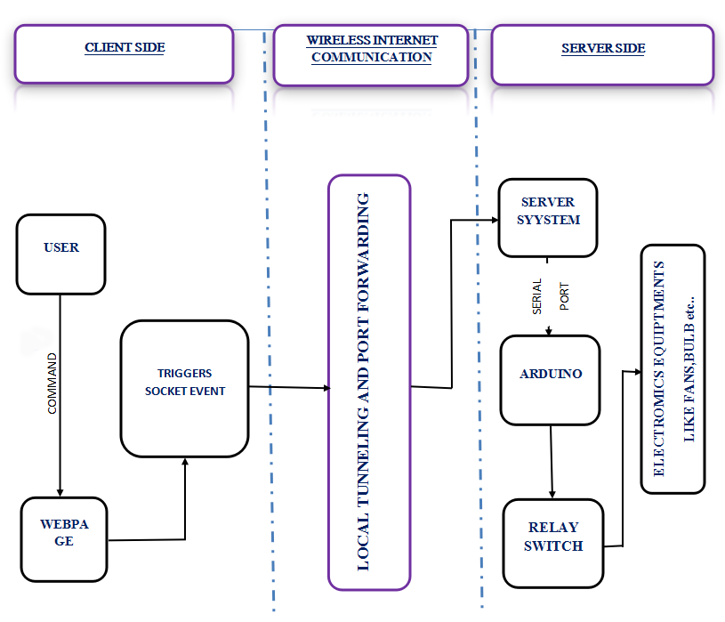
SYSTEM ARCHITECTURE:

Slide 10
MODULE DESCRIPTION:
Client Module
IoT Framework
Server Module

Slide 11
Client Module
The User touches the button in the webpage.
This triggers a socket event.
IoT Framework
The socket event then reaches the server where the IOT is connected.
This propagation of signal is done through port forwarding and local tunnelling.
Server Module
The server then sends the signal to Arduino.
The Arduino finally responds.
This request response cycle continues as long as the server is tunnelled.

Slide 12
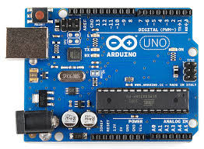
ARDUINO:
Arduino is an open source computer hardware and software company, project, and user community that designs and manufactures single-board microcontrollers and microcontroller kits for building digital devices and interactive objects that can sense and control objects in the physical world.

Slide 13
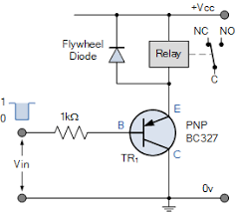
RELAY SWITCH:
A relay is an electrically operated switch. Many relays use an electromagnet to mechanically operate a switch, but other operating principles are also used, such as solid-state relays. Relays are used where it is necessary to control a circuit by a separate low-power signal, or where several circuits must be controlled by one signal.

Slide 14
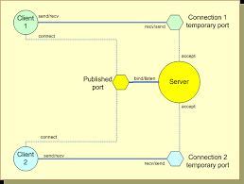
Socket Connection:
A network socket is an internal endpoint for sending or receiving data at a single node in a computer network. Concretely, it is a representation of this endpoint in networking software (protocol stack), such as an entry in a table (listing communication protocol, destination, status, etc.), and is a form of system resource.

Slide 15
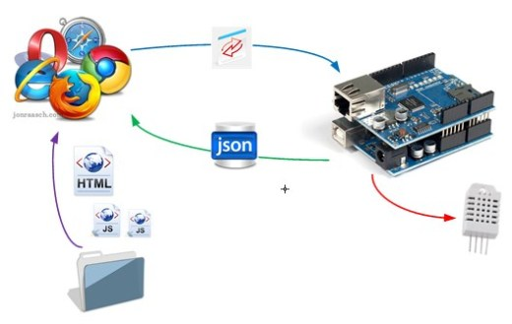
Software Firmata:
Firmata is a generic protocol for communicating with microcontrollers from software on a host computer. It is intended to work with any host computer software package. There are implementations for multiple microcontrollers and host software packages.

Slide 16
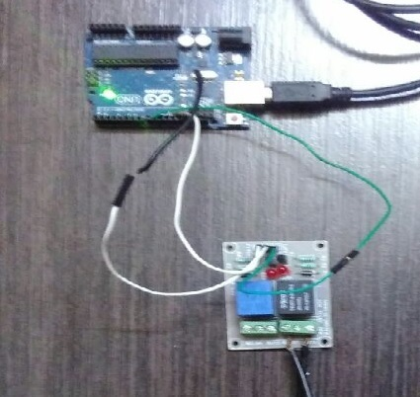
SCREENSHOTS:
Figure 1: Connection between the Relay switch and Arduino

Slide 17
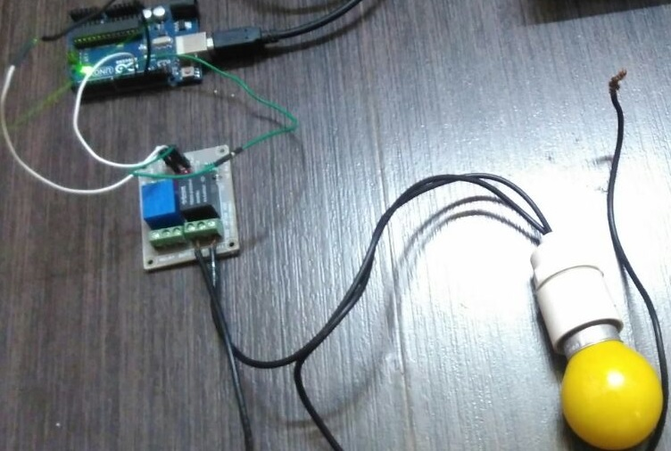
Figure 2: Connection with an Appliance

Slide 18
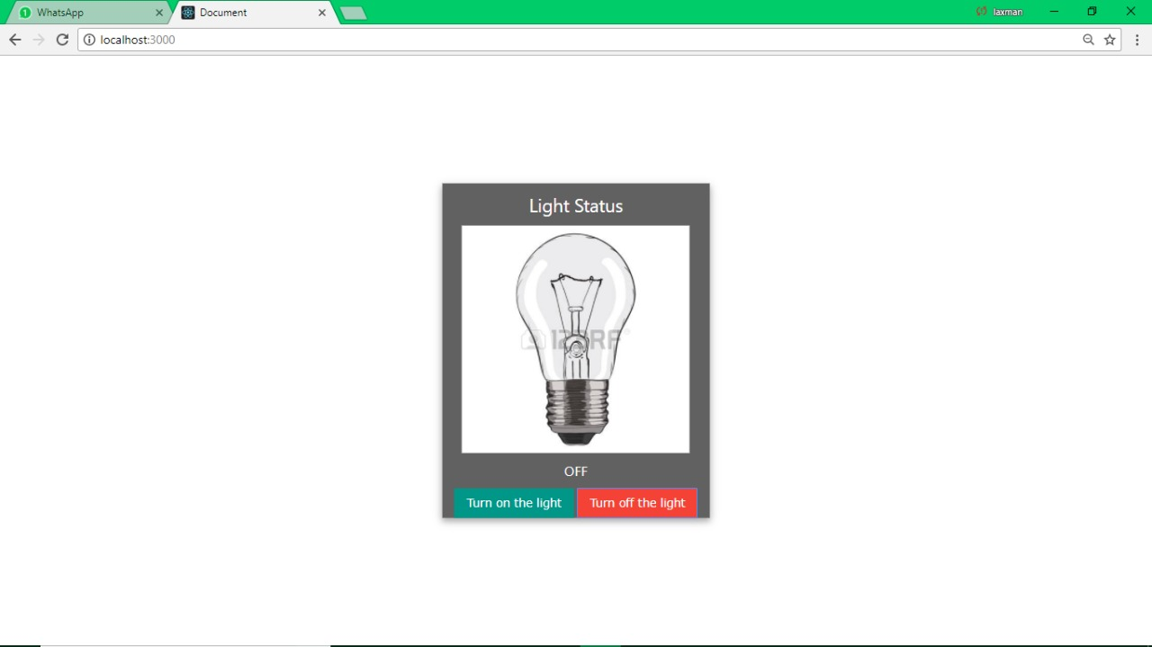
Figure 3:Web Application that indicates light is in off state

Slide 19
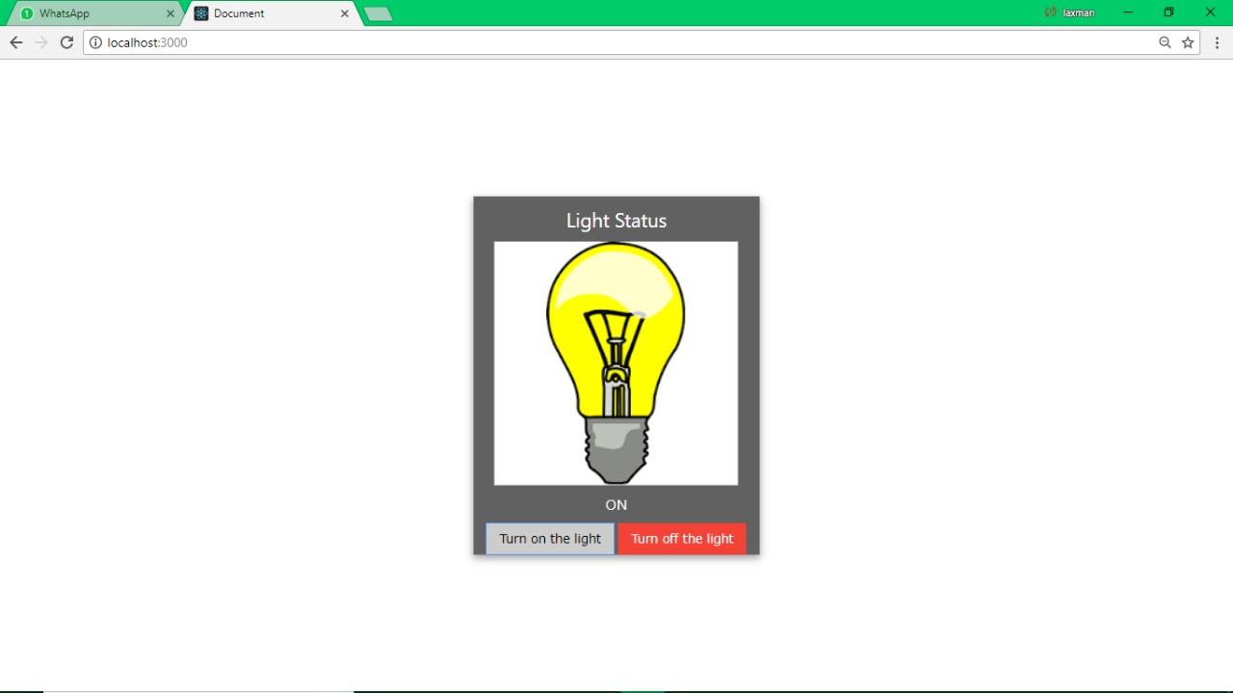
Figure 4:Receive user command and when to On State

Slide 20
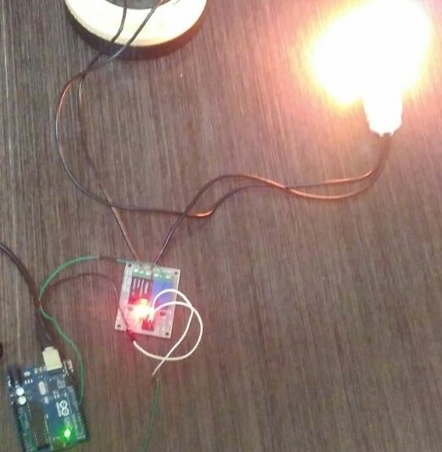
Figure 5:Output of controlling the appliances

Slide 21
CONCLUSION:
In the future, this technology may be even used in the brain computer interaction technologies to control physical devices with just thoughts!
On the business and household side, this technology could be exposed to automate several tasks and control the physical devices from online over any distance, without any cloud dependency.
The final thought is that all data presently available should be open sourced and all future data also should not be dumped into a particular server. This will lead to a democratic online society for the future.

Slide 22
REFERENCES:
[1] Mung Chiang, Tao Zhang,’’ Fog and IoT: An Overview of Research Opportunities” IEEE Internet of Things Journal ( Volume: 3, Issue: 6, Dec. 2016 ) Page(s): 854 – 864.
[2] Yuchen Yang, Longfei Wu, Guisheng Y,”A Survey on Security and Privacy Issues in Internet-of-Things’’in IEEE Internet of Things Journal (Volume: 4, Issue: 5, Oct. 2017 ),Page(s): 1250 – 1258
[3] Jie Lin, Wei Yu, Nan Zhang,’’ A Survey on Internet of Things: Architecture, Enabling Technologies, Security and Privacy, and Applications’’, IEEE Internet of Things Journal (Volume: 4, Issue: 5, Oct. 2017), Page(s): 1125 – 1142

Slide 23
[4] Ruinian Li; Tianyi Song; Nicholas Capurso; Jiguo Yu; Jason Couture; Xiuzhen Cheng,’’ IoT Applications on Secure Smart Shopping System” IEEE Internet of Things Journal (Volume: 4, Issue: 6, Dec. 2017) Publication Year: 2017, Page(s):1945-1954
[5] Shanzhi Chen; Hui Xu; Dake Liu; Bo Hu; Hucheng Wang,’’ A Vision of IoT: Applications, Challenges, and Opportunities with China Perspective” IEEE Internet of Things Journal, vol. 1, no. 4, august 2014 Publication Year: 2014, Page(s):349-359

Slide 24
THANK YOU

